Slide 1
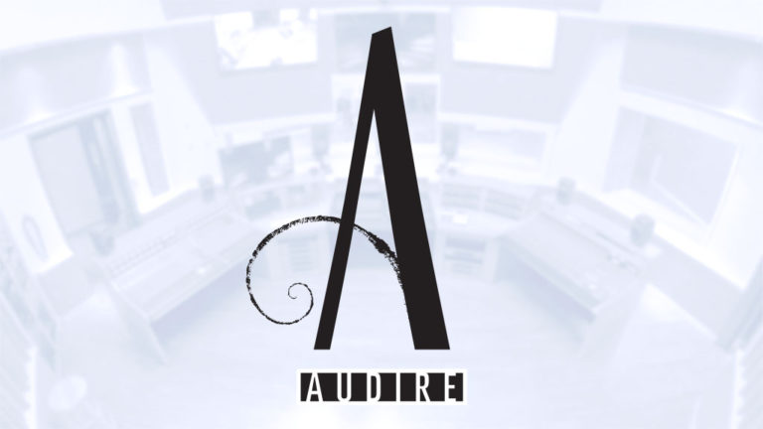

Case Studies for the use of
By Audire Design

Slide 2
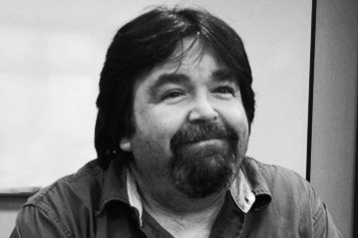
A little background
About your presenter…Joe Patten
25 years in the communication industry starting in the trenches as a technician.
Audio Visual, CCTV, Telcom, SCADA, LAN/WAN, Fiber specialist
Expertise in base building infrastructure; both large and small scale
Audio design, engineering, configuration, programming and commissioning
Principal with Audire Design, Associate with Communication Designs Associates

Slide 3

Audire Design
Audire Design delivers expertly engineered and installed commercial audio solutions for corporate, education, professional audio, house of worship and transportation industry clients both nationally and worldwide.
www.audiredesign.com

Slide 4
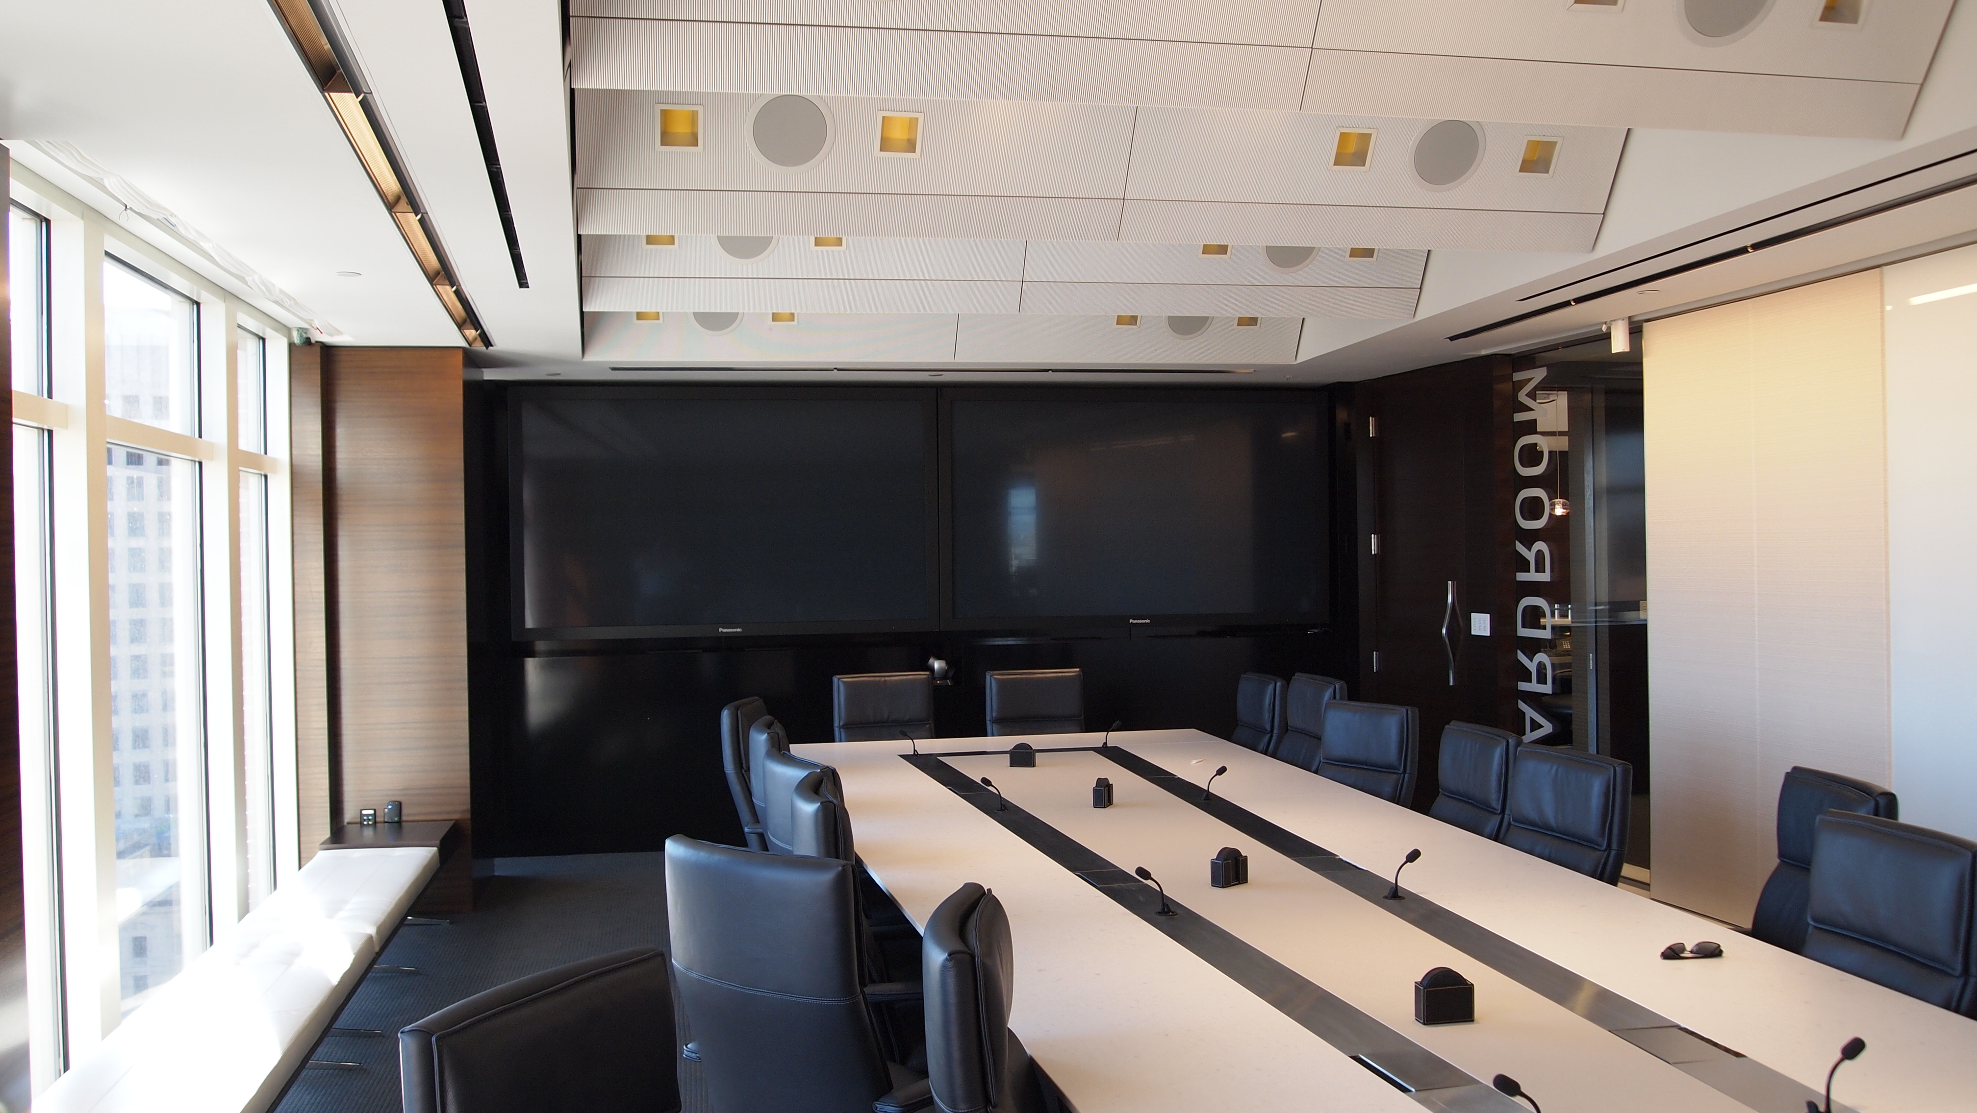
Design considerations (Old School)
Conference room example:
Each room would be it’s own “system” complete with separate HVAC, Electric, Storage.
Infrastructure was costly.

Slide 5
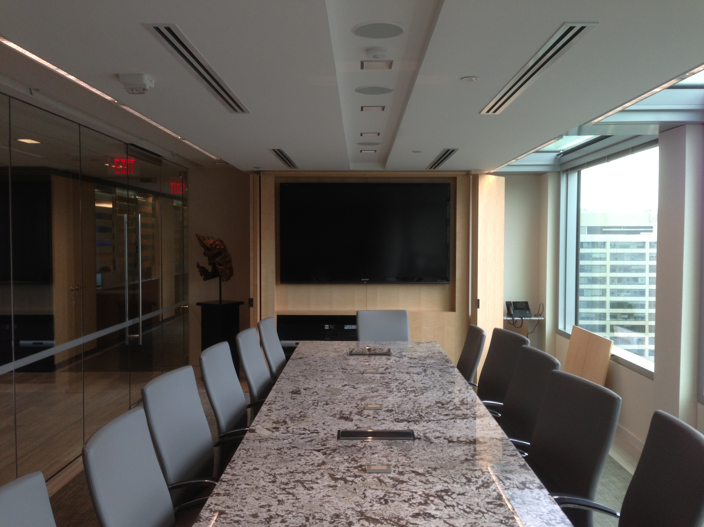
Design considerations (New School)
Conference room example:
Each room would be part of a bigger enterprise system with the ability to share equipment, HVAC and reduce space and a cleaner appearance.

Slide 6
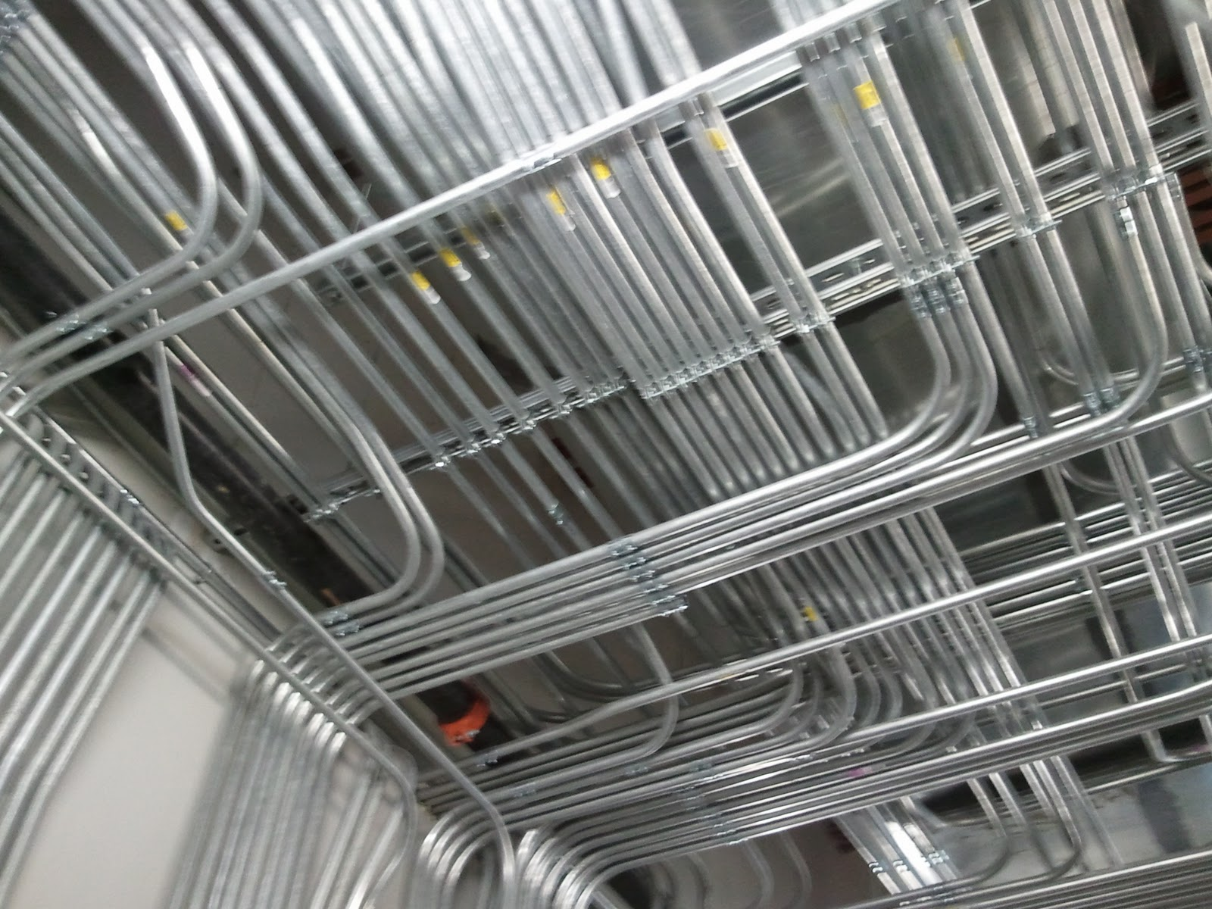
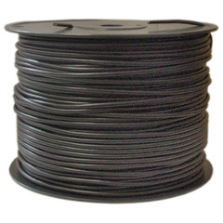
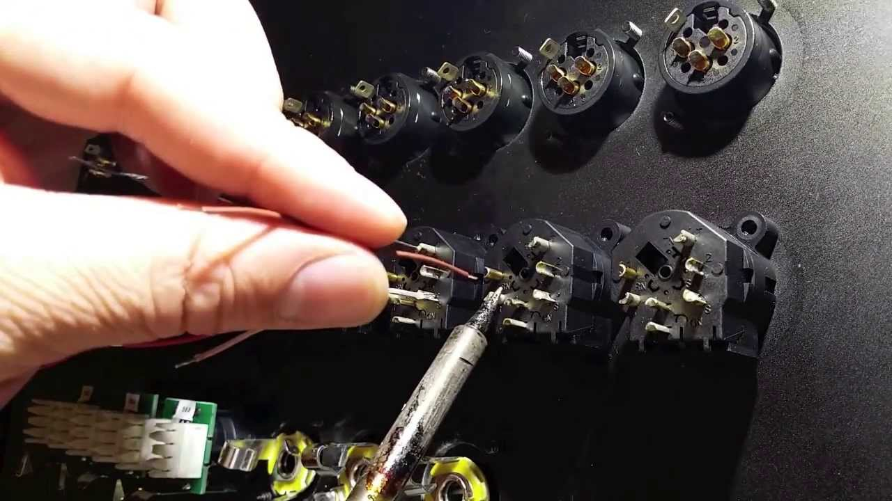
Cost Saving & Digital Audio Networking
With the cost of copper and the skill set necessary to terminate audio cable, how does the integrator reduce installation costs and also provide a robust audio installation?

Slide 7
Cost Comparison, Raw Cable
22AWG
w/drain wire stranded
(Belden 8761)
@ $.66 per foot (average)
128 channels – Analog audio
@ $84.48 per foot
Location 1 to 2 = 100 feet = $8448.00
Cable thickness 0.175
CAT6+
(350MHz), 4-Bonded-Pairs, U/UTP-Unshielded (Belden 1872a)
@ $.31 per foot (average)
128 channels – Digital Audio (DANTE)
@ $.31 per foot
Location 1 to 2 = 100 feet = $31.00
Cable thickness 0.365

Slide 8
Cost Comparison, Conduit
Analog Audio
128 channels:
100 feet of 3” conduit. $557.00
Per foot = $5.57
Digital Audio
128 channels:
100 feet of 0.75” conduit. $77.00
Per foot = $.77
Terminations/Labor:
256 XLR connectors: $2.60 each = $665.60
Labor to terminate @ 2.5 minutes per termination
Roughly 10 man hours @ $70 per hour = $700.00
One “link” between IDF closets = $1365.60
2 RJ45 connections: $.21 each = $.42
Labor to terminate @ 2.5 minutes per termination
5 minutes labor @ $70 per hour = $5.83
One “link” between IDF closets = $6.25

Slide 9
Distributed audio or centralized
Campus or Enterprise Audio.
Distributed:
Distributed audio has more equipment. Equipment real-estate and cooling can be an issue.
Distributed Analog audio requires many cable runs. The possibility of induction is also greater.
Conference room tables have limited space for microphone cable sometime causing conduit and/or routing problems.
Centralized:
Single location for equipment, ideal for maintenance including cooling.
Ability to share equipment between multiple rooms
Digital Audio allows less cabling between equipment rack and many conference rooms reducing installation costs.

Slide 10
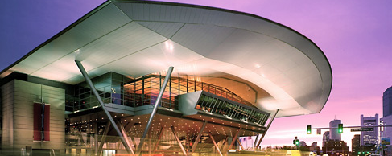
Boston Convention & Exhibition Center
Notes:
Flexibility, technology and convenience are built into the blueprint of this award-winning convention center.
The BCEC represents the next frontier of meeting planning—and the city itself. This stunning, innovative building provides dramatic, sweeping views of Boston’s expanding waterfront. The center embodies the spirit of innovation that sets this waterfront district apart—at the cutting edge of Boston’s economic and cultural future.

Slide 11
Boston Convention & Exhibition Center
516,000sf of contiguous exhibit space, 10 configurations
82 meeting rooms,160,000sf of configurable space
40,020sf column-free grand ballroom
300,000sf registration and function space
Free Wi-Fi, cell phone coverage throughout building
Utility floorboxes throughout serve any configuration
Notes:
Flexibility, technology and convenience are built into the blueprint of this award-winning convention center.
The BCEC represents the next frontier of meeting planning—and the city itself. This stunning, innovative building provides dramatic, sweeping views of Boston’s expanding waterfront. The center embodies the spirit of innovation that sets this waterfront district apart—at the cutting edge of Boston’s economic and cultural future.

Slide 12
Boston Convention & Exhibition Center
Audio Distribution System Overview
Original install, 2001 “State of the Art” Cobranet, 17 bundles total
2013 Upgrade Objective: “Future Proof” Ugrade = DANTE backbone
  48 IDF closets: DANTE DSP, Harman BSS DSPs, Crown amps
  6188 Dante audio I/O available
Cost Savings (average distance between IDF closets = 250 feet)
  Analog $1,081,965.60 (estimate) - Digital $12,966.25 (estimate)
  Delta $1,068,999.40 (win or lose the project)
Notes:
System was first installed in 2001 using “state of the art” Cobranet for digital transmission around the build. System utilized 17 different Cobranet bundles to route audio around building.
Customer wanted to “future proof” an audio upgrade. The use of Dante was chosen as the primary audio network backbone.
There are 48 IDF closets supporting AV throughout the building. Each IDF is outfitted with at least one DANTE enabled DSP to serve as the interface to the DANTE network. In each IDF closet there is a collection of amplifiers also communicating over a digital audio network. The use of Harman BSS DSPs and Crown Amplifiers kept transmission around the BCEC fully digital.
The customer may be expanding in the future and wanted to have the groundwork in place. DANTE was the clear choice. The current installation has 6188 audio I/O available

Slide 13
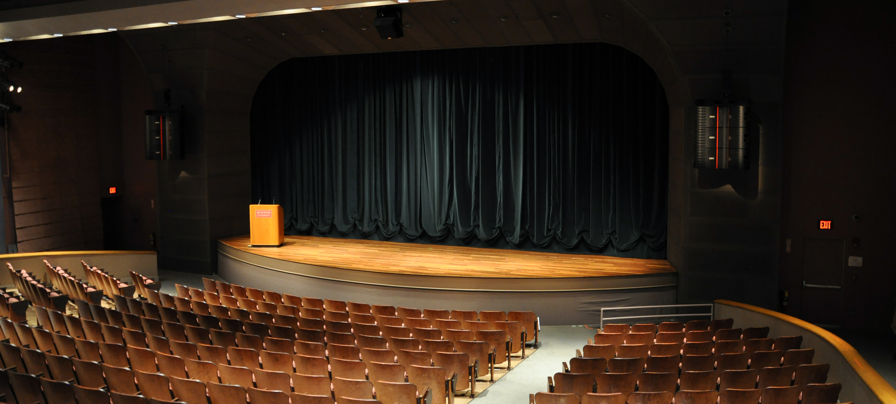
Boston University
Tsai Performance Center
Notes:
The Tsai Performance Center defines the ideal performance space for concerts, theatrical and dance presentations, lectures, film programs, and conferences. Situated at the heart of the Boston University campus, the Tsai Performance Center radiates simple warmth and elegance, yet it features fully supported sound and lighting systems to meet the most complex demands. The 41ˈ x 31ˈ proscenium stage offers excellent sight lines for all 515 seats in the house.

Slide 14
Boston University
Tsai Performance Center
Speaker System:
EAW Anya system - 3 flown stereo powered adaptive technology speaker boxes per side
EAW QX326 center speaker, powered by a Lab Gruppen D80 amplifier using EAW Greybox technology
System is fully networked via Dante
2 Mixing Console, 3 Mix Positions:
Yamaha QL1 consoles on Dante network
Production booth (behind balcony), center house,
backstage right
Notes:
The Tsai Performance Center defines the ideal performance space for concerts, theatrical and dance presentations, lectures, film programs, and conferences. Situated at the heart of the Boston University campus, the Tsai Performance Center radiates simple warmth and elegance, yet it features fully supported sound and lighting systems to meet the most complex demands. The 41ˈ x 31ˈ proscenium stage offers excellent sight lines for all 515 seats in the house.

Slide 15
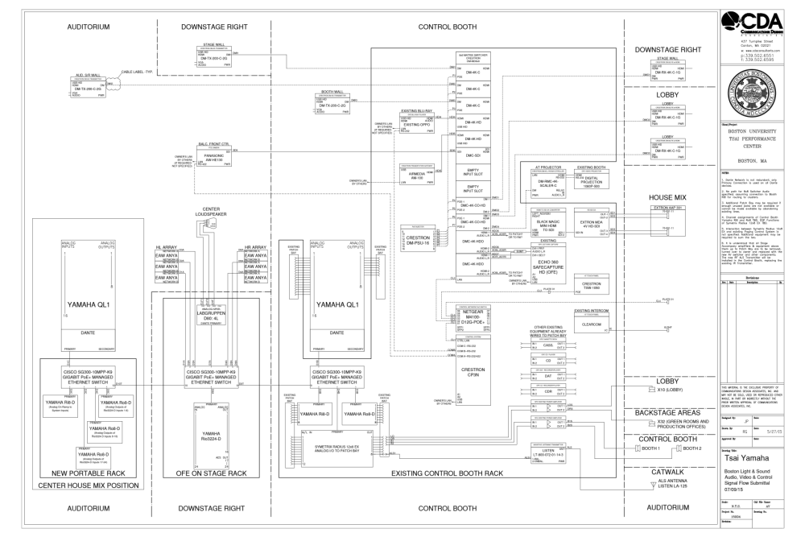
Boston University
Tsai Performance Center

Slide 16
Boston University Tsai Performance Center
Key Design Considerations
Original system ALL analog – patch panels/wall plates
Needed NEW “universal” mix position to accommodate touring systems
Analog cabling, patching, routing MADE NO SENSE
Key Solution: DANTE
DANTE: Great product selection to best suit the design
Easily interconnects EAW, Lab Gruppen, Yamaha, Symetrix and Shure
DANTE per manufacturer adoption MADE MOST SENSE
Notes:
Key design considerations
Original system was completely analog with analog patch panels and multiple analog wall plates.
Needed a new “universal” mix position to accommodate touring systems. Analog cabling, patch panels and routing just didn’t make sense.
DANTE made the most sense as the Digital audio transport system due to the manufacturer adoption. It allowed for great product selection to best suit the design.
DANTE interconnects manufacturers, EAW, Lab Gruppen, Yamaha, Symetrix and Shure to play very nicely in the same sandbox

Slide 17
AUDIRE DESIGN, INC.
51 Warren Street
Medford, MA 02155
Phone: (617) 902-0660
Email: info@audiredesign.com
Web: Audiredesign.com

